Slide 1
Simulations of the Neutrino-Driven Wind
Brian Nevins

Slide 2
What is the neutrino-driven wind?
Stellar material blown off of a proto-neutron star by neutrino reactions
Site of interesting nucleosynthesis

Slide 3
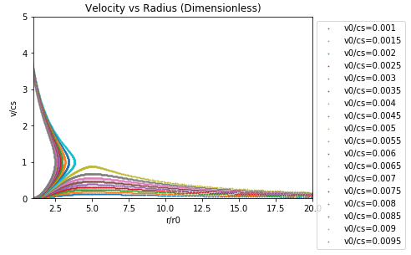
The Simulations
Elements formed depend on mass-loss rate from the star due to the wind
Mass-loss rate can be mapped to the starting velocity of the material as it is ejected from the star
The simulation searches for the critical starting velocity by integrating several ODEs and looking for a realistic velocity vs radius curve

Slide 4
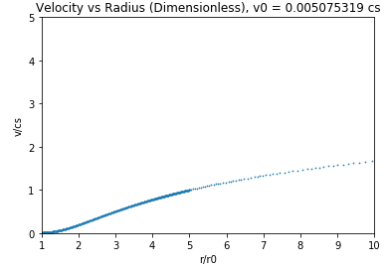
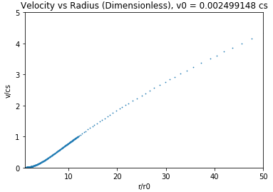
Results
Critical velocities found for isothermal and ideal gas equations of state

Slide 5
Future Work
Generalize code for any equation of state
Modify ODEs to include heating effects
Optimize code/convert to C

